Slide 1
HC05 + DHT22 + ARDUINO + MOBILE APP
Sensor Data Transmission via Bluetooth

Slide 2
DHT22
The DHT22 sensor is a low-cost, digital humidity and temperature sensor. It measures humidity in the range of 20-90% with an accuracy of ±2%, and temperature in the range of -40 to 80 °C with an accuracy of ±0.5 °C.
The sensor uses a capacitive humidity sensor and a thermistor to measure the surrounding air, and it communicates with microcontrollers such as the Arduino via a single digital pin.
The DHT22 sensor is also known as AM2302. It is easy to interface with microcontroller and it requires very minimal amount of data and power, making it suitable for a wide range of applications, including home automation, weather stations, HVAC systems and many more. It also has a long life span and it can be operated in a wide range of temperature and humidity.

Slide 3

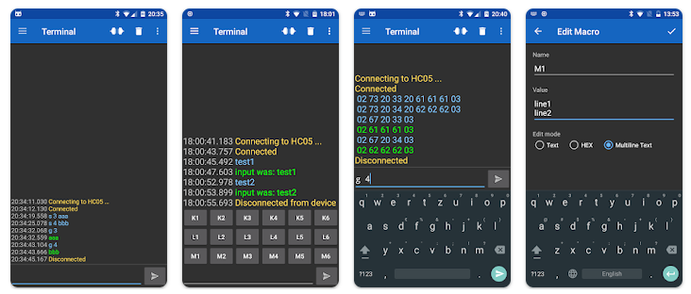
Serial Bluetooth Terminal
'Serial Bluetooth Terminal' is a mobile application that allows you to connect to microcontrollers, Arduinos, and other devices with a serial or UART interface using a Bluetooth to serial converter. This app can connect to devices using both Bluetooth Classic and Bluetooth Low Energy (BLE) and it provides a line-oriented terminal or console interface to interact with your device.

Slide 4
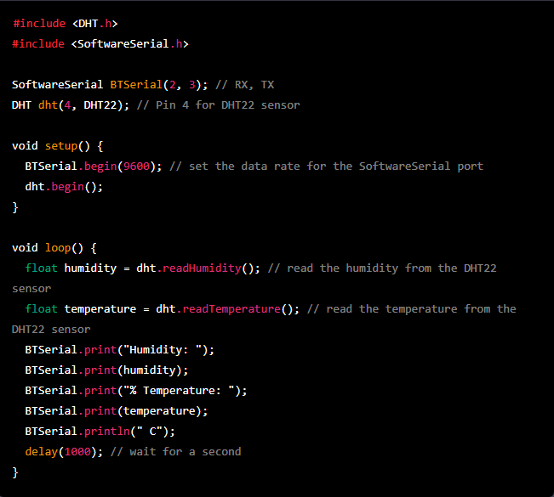
Code for transmitting sensor data via bluetooth

Slide 5
Code Explanation
The HC-05 Bluetooth module is connected to the Arduino using the SoftwareSerial library, with the RX pin connected to pin 2 and the TX pin connected to pin 3.
The DHT22 sensor is connected to pin 4, and the script uses the DHT library to read the humidity and temperature data from the sensor.
The humidity and temperature data is then sent via Bluetooth using the BTSerial.print() and BTSerial.println() functions.
The script waits for a second before taking the next reading.
To display the humidity and temperature on a mobile device, you can use a smartphone app such as "Serial Bluetooth Terminal" or "Bluetooth Terminal" to connect to the HC-05 module and display the data received in a user-friendly format.
Please note that the script provided here is a general example, you may need to adjust the script according to the specific application or requirement, including the baud rate of the HC-05 module and the pin connection of the DHT22 sensor.
Also, make sure that you've installed the DHT library for arduino.

Slide 6
Q&As

